Slide 1
Supervised and Unsupervised Learning
RX 319
Introduction to Healthcare Analytics

Slide 2
Learning Objectives
Compare and contrast artificial intelligence and machine learning.
Contrast supervised and unsupervised learning.
2

Slide 3

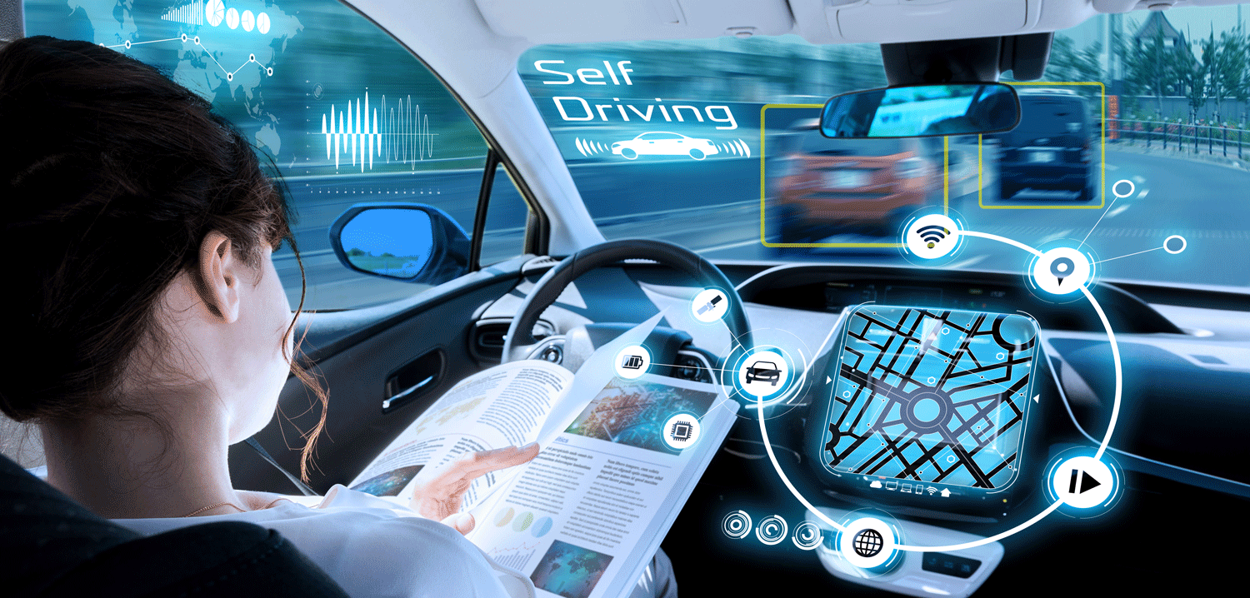
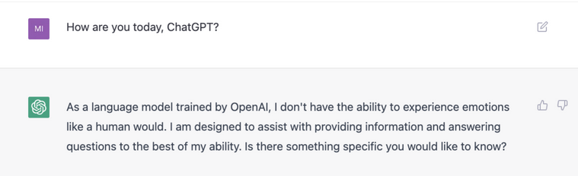
“Learning from Data”
https://towardsdatascience.com/netflix-and-chill-building-a-recommendation-system-in-excel-c69b33c914f4
https://www.autonomousvehicleinternational.com/news/adas/enthusiasm-for-self-driving-cars-to-double.html
3
https://mashable.com/article/chatgpt-amazing-wrong

Slide 4

But why?
“Primary care physicians spend nearly 6 hours interacting with EHR’s during and after clinic hours.”
AI can help decrease this time → Free up time for patient care
Goal: To provide the necessary information to experts, so they can make expert decisions
This Photo by Unknown Author is licensed under CC BY-SA
4
Source: IBM. “Improving Healthcare: The Role of Artificial Intelligence”

Slide 5
Machine Learning and Artificial Intelligence
Artificial Intelligence (AI) is a broad field, where scientists are trying to program computers to “think” like humans
Machine Learning (ML) is a subfield within AI – the models that help the computer “learn”
5

Slide 6
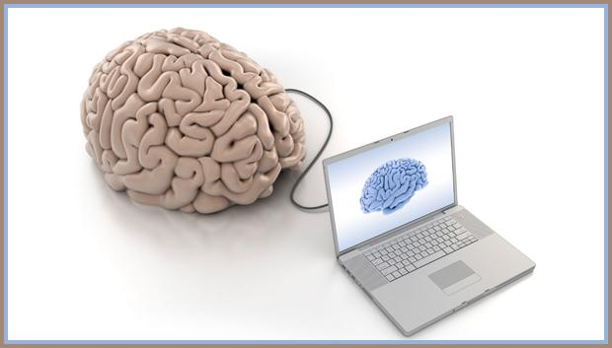
How is it “learning”?
Math, mostly
Developers have programmed methods & tools that allow computers to
Recognize patterns
Predict results
Identify similarities & differences
All based on the input data
6

Slide 7
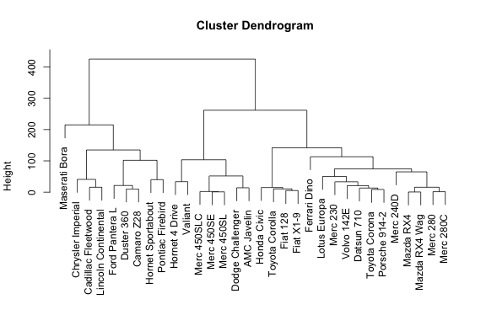
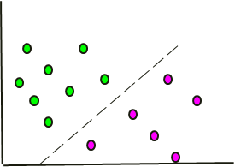
Types of Machine Learning
Unsupervised Analysis
Supervised Analysis
Which people/things are similar to each other?
Can we predict a result based on features?
Feature 2
Feature 1
7

